Slide 1
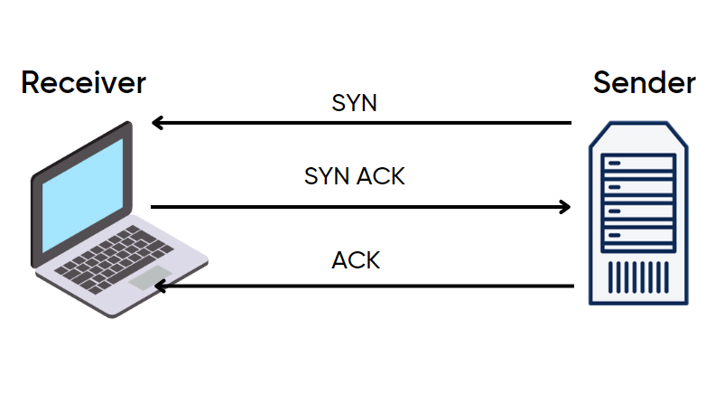
3-way Handshaking
By
Dr Yasir Afaq

Slide 2
Three Ways Handshake
Three-Way HandShake or a TCP 3-way handshake is a process which is used in a TCP/IP network to make a connection between the server and client.
It is a three-step process that requires both the client and server to exchange synchronization and acknowledgment packets before the real data communication process starts.
Three-way handshake process is designed in such a way that both ends help you to initiate, negotiate, and separate TCP socket connections at the same time.
It allows you to transfer multiple TCP socket connections in both directions at the same time.

Slide 3
TCP message types
Message | Description
Syn | Used to initiate and establish a connection. It also helps you to synchronize sequence numbers between devices.
ACK | Helps to confirm to the other side that it has received the SYN.
SYN-ACK | SYN message from local device and ACK of the earlier packet.
FIN | Used to terminate a connection.

Slide 4
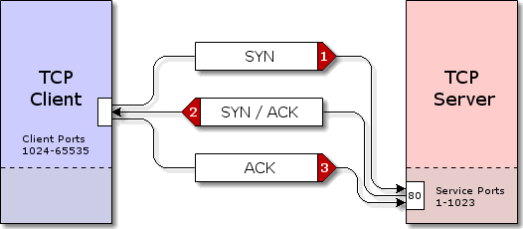
TCP Three-Way Handshake Process
TCP traffic begins with a three-way handshake. In this TCP handshake process, a client needs to initiate the conversation by requesting a communication session with the Server:
Step 1: In the first step, the client establishes a connection with a server. It sends a segment with SYN and informs the server about the client should start communication, and with what should be its sequence number.
Step 2: In this step server responds to the client request with SYN-ACK signal set. ACK helps you to signify the response of segment that is received and SYN signifies what sequence number it should able to start with the segments.
Step 3: In this final step, the client acknowledges the response of the Server, and they both create a stable connection will begin the actual data transfer process.

Slide 5
Real Work Example
Here is a simple example of the three-way handshake process that is consists of three steps:
Host X begins the connection by sending the TCP SYN packet to its host destination. The packets contain a random sequence number (For example, 4321) that indicates the beginning of the sequence numbers for data that the Host X should transmit.
After that, the Server will receive the packet, and it responds with its sequence number. It’s response also includes the acknowledgment number, that is Host X’s sequence number incremented with 1 (Here, it is 4322).
Host X responds to the Server by sending the acknowledgment number that is mostly server’s sequence number that is incremented by 1.
After the data transmission process is over, TCP automatically terminates the connection between two separate endpoints.

Slide 6
Key Points
TCP 3-way handshake or three-way handshake or TCP 3-way handshake is a process which is used in a TCP/IP network to make a connection between server and client.
Syn use to initiate and establish a connection
ACK helps to confirm to the other side that it has received the SYN.
SYN-ACK is a SYN message from local device and ACK of the earlier packet.
FIN is used for terminating a connection.
TCP handshake process, a client needs to initiate the conversation by requesting a communication session with the Server
In the first step, the client establishes a connection with a server
In this second step, the server responds to the client request with SYN-ACK signal set
In this final step, the client acknowledges the response of the Server
TCP automatically terminates the connection between two separate endpoints.

Slide 7
SCTP Protocol
SCTP stands for Stream Control Transmission Protocol.
It is a connection- oriented protocol in computer networks which provides a full-duplex association i.e., transmitting multiple streams of data between two end points at the same time that have established a connection in network.
It is sometimes referred to as next generation TCP or TCPng, SCTP makes it easier to support telephonic conversation on Internet.
A telephonic conversation requires transmitting of voice along with other data at the same time on both ends, SCTP protocol makes it easier to establish reliable connection.

Slide 8
Characteristics of SCTP :
Unicast with Multiple properties –
It is a point-to-point protocol which can use different paths to reach end host.
Reliable Transmission –
It uses SACK and checksums to detect damaged, corrupted, discarded, duplicate and reordered data. It is similar to TCP but SCTP is more efficient when it comes to reordering of data.
Message oriented –
Each message can be framed and we can keep order of datastream and tabs on structure. For this, In TCP, we need a different layer for abstraction.
Multi-homing
It can establish multiple connection paths between two end points and does not need to rely on IP layer for resilience

Slide 9
Congestion Control

Slide 10
Congestion
A state occurring in network layer when the message traffic is so heavy that it slows down network response time.
Effects of Congestion
As delay increases, performance decreases.
If delay increases, retransmission occurs, making situation worse.

Slide 11
Congestion control algorithms
Congestion Control is a mechanism that controls the entry of data packets into the network, enabling a better use of a shared network infrastructure and avoiding congestive collapse.
Congestive-Avoidance Algorithms (CAA) are implemented at the TCP layer as the mechanism to avoid congestive collapse in a network.
There are two congestion control algorithm which are as follows:

Slide 12
Leaky Bucket Algorithm
The leaky bucket algorithm discovers its use in the context of network traffic shaping or rate-limiting.
A leaky bucket execution and a token bucket execution are predominantly used for traffic shaping algorithms.
This algorithm is used to control the rate at which traffic is sent to the network and shape the burst traffic to a steady traffic stream.
The disadvantages compared with the leaky-bucket algorithm are the inefficient use of available network resources.
The large area of network resources such as bandwidth is not being used effectively.

Slide 13
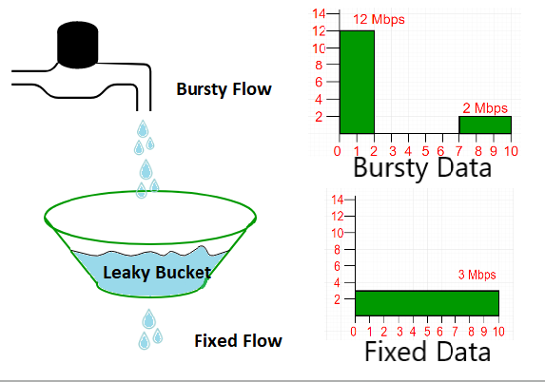
Example
Let us consider the following example:
Suppose we have a bucket in which we are pouring water, at random points in time, but we have to get water at a fixed rate, to achieve this we will make a hole at the bottom of the bucket.
This will ensure that the water coming out is at some fixed rate, and also if the bucket gets full, then we will stop pouring water into it.
The input rate can vary, but the output rate remains constant. Similarly, in networking, a technique called leaky bucket can smooth out bursty traffic.
Bursty chunks are stored in the bucket and sent out at an average rate.

Slide 14
Example
In the above figure, we assume that the network has committed a bandwidth of 3 Mbps for a host. The use of the leaky bucket shapes the input traffic to make it conform to this commitment. In the above figure, the host sends a burst of data at a rate of 12 Mbps for 2s, for a total of 24 Mbits of data.
The host is silent for 5 s and then sends data at a rate of 2 Mbps for 3 s, for a total of 6 Mbits of data.
In all, the host has sent 30 Mbits of data in 10 s. The leaky bucket smooths out the traffic by sending out data at a rate of 3 Mbps during the same 10 s.
Without the leaky bucket, the beginning burst may have hurt the network by consuming more bandwidth than is set aside for this host.
We can also see that the leaky bucket may prevent congestion.

Slide 15
Leaky Bucket Algorithm
A simple leaky bucket algorithm can be implemented using FIFO queue. A FIFO queue holds the packets. If the traffic consists of fixed-size packets (e.g., cells in ATM networks), the process removes a fixed number of packets from the queue at each tick of the clock. If the traffic consists of variable-length packets, the fixed output rate must be based on the number of bytes or bits.
The following is an algorithm for variable-length packets:
Initialize a counter to n at the tick of the clock.
Repeat until n is smaller than the packet size of the packet at the head of the queue.
Pop a packet out of the head of the queue, say P.
Send the packet P, into the network
Decrement the counter by the size of packet P.
Reset the counter and go to step 1.

Slide 16
Task: Token bucket Algorithm

